Slide 1
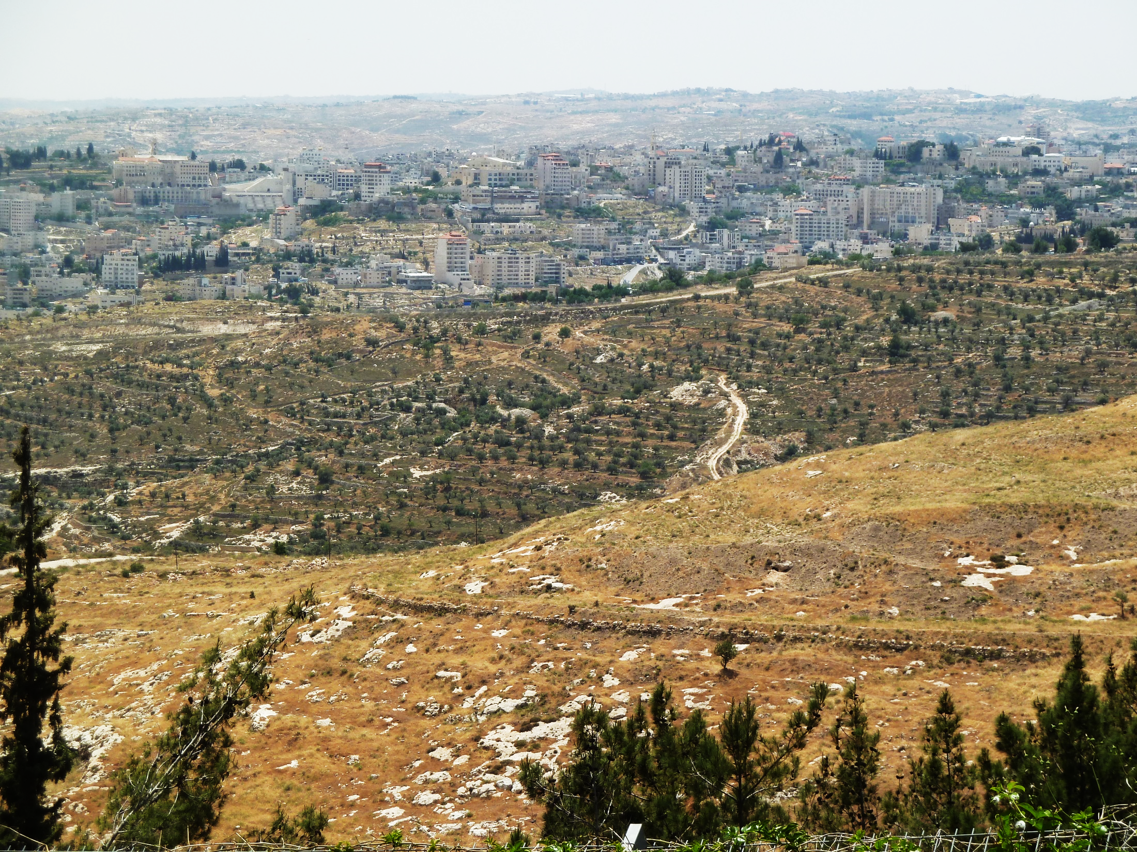
Ruth 1.6-2.23
Bethlehem

Slide 3
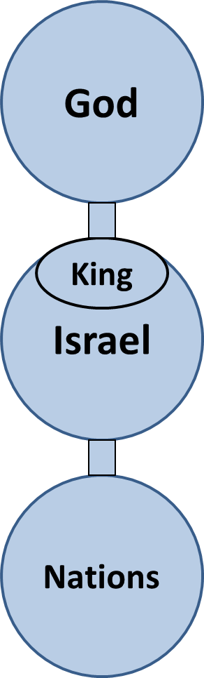

Slide 4
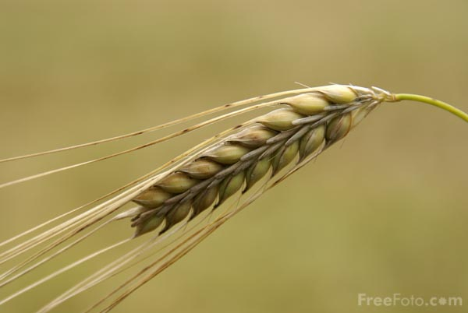
Ruth 1.6-7: Then she arose with her daughters-in-law that she might return from the land of Moab, for she had heard in the land of Moab that the LORD had visited His people [the Israelites] in giving them food. 7So she departed from the place where she was, and her two daughters-in-law with her; and they went on the way to return to the land of Judah. Photo from freefoto.com

Slide 5

Ruth 1.8-10: And Naomi said to her two daughters-in-law, “Go, return each of you to her mother's house. May the LORD deal kindly with you as you have dealt with the dead and with me. ⁹May the LORD grant that you may find rest, each in the house of her husband.” Then she kissed them, and they lifted up their voices and wept. ¹⁰And they said to her, “No, but we will surely return with you to your people.” Photo from freefoto.com

Slide 6
Ruth 1.11: But Naomi said, “Return, my daughters. Why should you go with me? Have I yet sons in my womb, that they may be your husbands?”

Slide 7
Ruth 1.12-15: “Return, my daughters! Go, for I am too old to have a husband. If I said I have hope, if I should even have a husband tonight and also bear sons, would you therefore wait until they were grown? Would you therefore refrain from marrying? No, my daughters; for it is harder for me than for you, for the hand of the LORD has gone forth against me.” And they lifted up their voices and wept again; and Orpah kissed her mother-in-law, but Ruth clung to her. Then she said, “Behold, your sister-in-law has gone back to her people and her gods; return after your sister-in-law.”

Slide 10
Ruth 1.13: “…for it is harder for me than for you, for the hand of the LORD has gone forth against me.”

Slide 11
In the Bible, a “good” character is one who believes in God’s revelation and acts on it, one who takes the “top line.”
The “fool” is the one who turns away from God’s revelation and acts in the flesh, on the “bottom line.”

Slide 12
Ruth 1.16-18: But Ruth said, “Do not urge me to leave you or turn back from following you; for where you go, I will go, and where you lodge, I will lodge. Your people shall be my people, and your God, my God. Where you die, I will die, and there I will be buried. Thus may the LORD do to me, and worse, if anything but death parts you and me.” When she saw that she was determined to go with her, she said no more to her.

Slide 13
Naomi – Israelite
Disobedient to Law
Weak in faith
Seeks answers in human reasoning
Fails to represent God
Ruth – Moabite
Obedient to Law
Trusts in God’s promises
Seeks answers in God’s revelation
Loyal to Yahweh

Slide 14
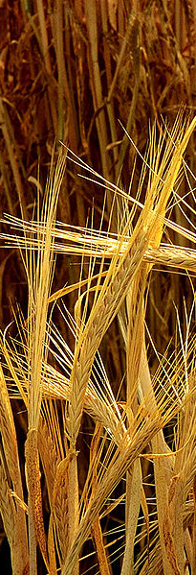
Deuteronomy 10.17-19: For the LORD your God is the God of gods and the Lord of lords, the great, the mighty, and the awesome God who does not show partiality nor take a bribe. He executes justice for the orphan and the widow, and shows His love for the alien by giving him food and clothing. So show your love for the alien, for you were aliens in the land of Egypt.
Photo from commons.wikipedia.com

Slide 15
Naomi – Israelite
Disobedient to Law
Weak in faith
Seeks answers in human reasoning
Fails to represent God
Ruth – Moabite
Obedient to Law
Trusts in God’s promises
Seeks answers in God’s revelation
Loyal to Yahweh

Slide 16
Ruth 1.19-21: So they both went until they came to Bethlehem. And when they had come to Bethlehem, all the city was stirred because of them, and the women said, “Is this Naomi?” She said to them, “Do not call me Naomi; call me Mara, for the Almighty has dealt very bitterly with me. I went out full, but the LORD has brought me back empty. Why do you call me Naomi, since the LORD has witnessed against me and the Almighty has afflicted me?”

Slide 17
Ruth 1.22-2.2: So Naomi returned, and with her Ruth the Moabitess, her daughter-in-law, who returned from the land of Moab. And they came to Bethlehem at the beginning of barley harvest. Now Naomi had a kinsman of her husband, a man of great wealth, of the family of Elimelech, whose name was Boaz. And Ruth the Moabitess said to Naomi, “Please let me go to the field and glean among the ears of grain after one in whose sight I may find favor.” And she said to her, “Go, my daughter.”

Slide 18
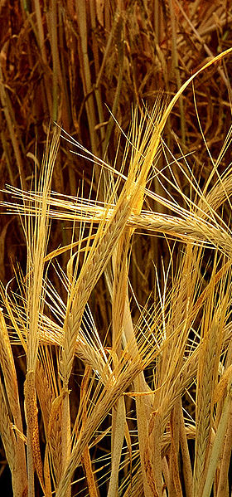
Leviticus 19.9-10: Now when you reap the harvest of your land, you shall not reap to the very corners of your field, nor shall you gather the gleanings of your harvest. Nor shall you glean your vineyard, nor shall you gather the fallen fruit of your vineyard; you shall leave them for the needy and for the stranger. I am the LORD your God.
Photo from commons.wikipedia.com

Slide 19
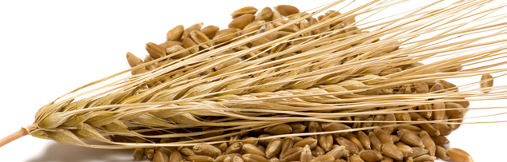
Deuteronomy 24:19: When you reap your harvest in your field and have forgotten a sheaf in the field, you shall not go back to get it; it shall be for the alien, for the orphan, and for the widow, in order that the LORD your God may bless you in all the work of your hands. Photo from www.homecookingadventure.com

Slide 20
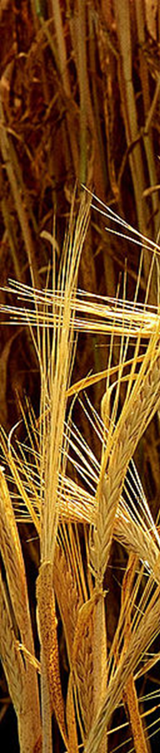
Ruth 2.3-5: So she departed and went and gleaned in the field after the reapers; and she happened to come to the portion of the field belonging to Boaz, who was of the family of Elimelech. Now behold, Boaz came from Bethlehem and said to the reapers, “May the LORD be with you.” And they said to him, “May the LORD bless you.” Then Boaz said to his servant who was in charge of the reapers, “Whose young woman is this?”

Slide 21
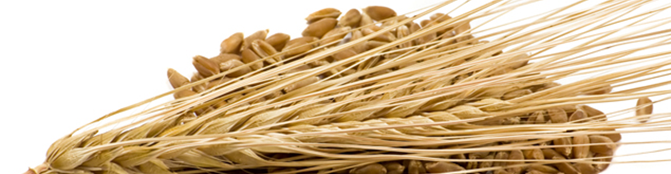
Ruth 2.6-7: The servant in charge of the reapers replied, “She is the young Moabite woman who returned with Naomi from the land of Moab. And she said, ‘Please let me glean and gather after the reapers among the sheaves.’ Thus she came and has remained from the morning until now; she has been sitting in the house for a little while.”

Slide 22
Ruth 2.8-10: Then Boaz said to Ruth, “Listen carefully, my daughter. Do not go to glean in another field; furthermore, do not go on from this one, but stay here with my maids. Let your eyes be on the field which they reap, and go after them. Indeed, I have commanded the servants not to touch you. When you are thirsty, go to the water jars and drink from what the servants draw.” Then she fell on her face, bowing to the ground and said to him, “Why have I found favor in your sight that you should take notice of me, since I am a foreigner?”

Slide 23
Ruth 2.11-13: Boaz replied to her, “All that you have done for your mother-in-law after the death of your husband has been fully reported to me, and how you left your father and your mother and the land of your birth, and came to a people that you did not previously know. May the LORD reward your work, and your wages be full from the LORD, the God of Israel, under whose wings you have come to seek refuge.” Then she said, “I have found favor in your sight, my lord, for you have comforted me and indeed have spoken kindly to your maidservant, though I am not like one of your maidservants.”

Slide 24
Ruth 2.14-17: At mealtime Boaz said to her, “Come here, that you may eat of the bread and dip your piece of bread in the vinegar.” So she sat beside the reapers; and he served her roasted grain, and she ate and was satisfied and had some left. When she rose to glean, Boaz commanded his servants, saying, “Let her glean even among the sheaves, and do not insult her. Also you shall purposely pull out for her some grain from the bundles and leave it that she may glean, and do not rebuke her.” So she gleaned in the field until evening. Then she beat out what she had gleaned, and it was about an ephah of barley.

Slide 25
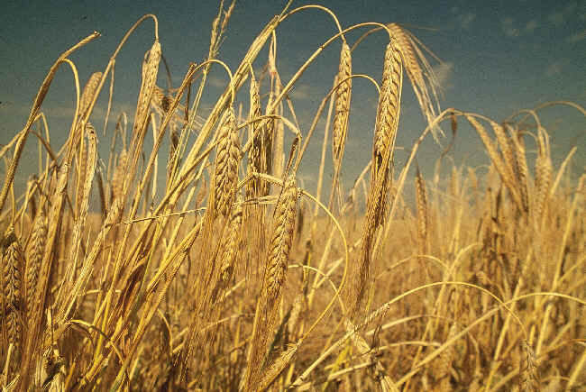
Ruth 2.12: “May the LORD reward your work, and your wages be full from the LORD, the God of Israel, under whose wings you have come to seek refuge.”

Slide 26
Ruth 2.18-19: She took it up and went into the city, and her mother-in-law saw what she had gleaned. She also took it out and gave Naomi what she had left after she was satisfied. Her mother-in-law then said to her, “Where did you glean today and where did you work? May he who took notice of you be blessed.” So she told her mother-in-law with whom she had worked and said, “The name of the man with whom I worked today is Boaz.”

Slide 27
Ruth 2.20: Naomi said to her daughter-in-law, “May he be blessed of the LORD who has not withdrawn his kindness to the living and to the dead.” Again Naomi said to her, “The man is our relative, he is one of our closest relatives.”
גָּאַל

Slide 28
Ruth 2.20: Naomi said to her daughter-in-law, “May he be blessed of the LORD who has not withdrawn his kindness to the living and to the dead.” Again Naomi said to her, “The man is our relative, he is one of our closest relatives.”
גָּאַל
Leviticus 25.25: “If a fellow countryman of yours becomes so poor he has to sell part of his property, then his nearest kinsman is to come and buy back what his relative has sold.”

Slide 29
Ruth 2.21-23: Then Ruth the Moabitess said, “Furthermore, he said to me, ‘You should stay close to my servants until they have finished all my harvest.’” Naomi said to Ruth her daughter-in-law, “It is good, my daughter, that you go out with his maids, so that others do not fall upon you in another field.” So she stayed close by the maids of Boaz in order to glean until the end of the barley harvest and the wheat harvest. And she lived with her mother-in-law.

Slide 30
Narrative Interpretation
1. Always keep in mind the historical and literary contexts.
2. Watch for what the author emphasizes.
3. Evaluate characters as “good” or “bad” based on the assumed standard; in the Bible this is God’s standard: whether the character walks the top line or the bottom line.
4. Seek to understand what irony signifies.

Slide 31
Narrative Plot
1. Naomi returns to Israel, since God has resumed blessing the land with food.
2. Naomi tries to send her daughters-in-law back to their old families and old gods, but Ruth chose to obey her marriage obligation and trust in the true God.
3. Naomi got bitter and blamed God, but Ruth sought an answer for the food tension in the Mosaic Law.
4. Ruth met Boaz, Elimelech’s brother, who represented God well by over-blessing.

Slide 32
Narrative Application
1. Don’t be the subject of God’s irony! Be a protagonist instead.
2. Don’t blame God for the results of your mistakes. Repent instead.
3. Seek refuge under God’s wings.
4. Be an over-blesser who helps those in need.
5. Remember that God is a redeemer, and Jesus paid the price to redeem us from our captivity to sin, death, evil, and even the Law.

